Slide 1
heapsort
CS340

Slide 2
Heapsort Properties
Combines the best properties of insertion sort and merge sort
O(n lg n) worst case
Sorts in place (no extra storage needed)

Slide 3
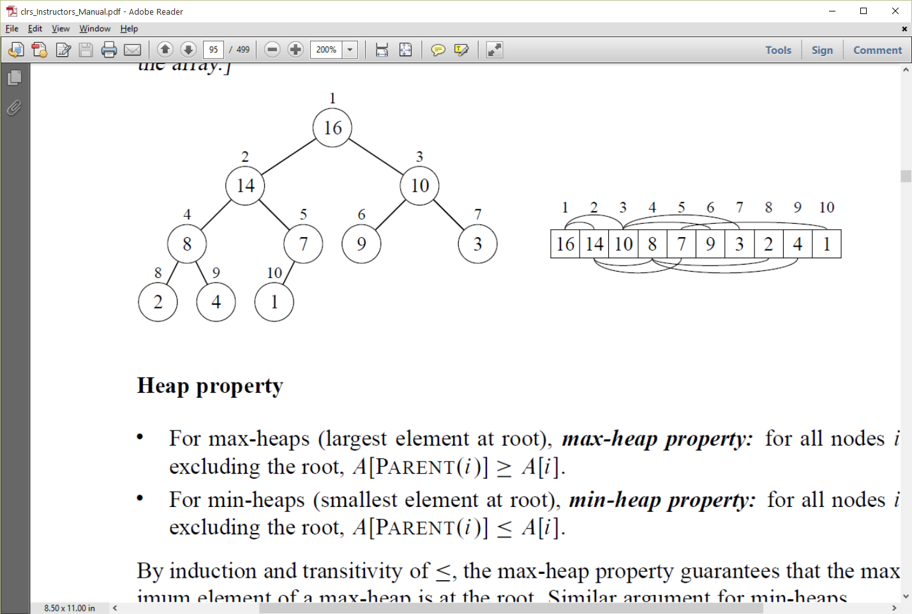
Properties of a heap
A nearly-complete binary tree.
Max-heap or min-heap.
Largest element is at the root of a max-heap.
The Heap Property (max heap): Parent node ≥ its children
Recursive definition: Each node is the root of its own heap.
Height of node = # of edges from the node down to a leaf.
Height of heap = height of root = Θ(lg n).

Slide 4
Heap stored as array
Root = max value = A[1]
Parent of A[i] = A[i/2]
Left child of A[i] = A[2i]; Right child of A[i] = A[2i+1]
Computing is fast with binary representation

Slide 5
Heapsort basic methods
int parent(int i) {
}
int left(int i) {
}
int right(int i) {
}
In a max-heap, A[parent(i)] ≥ A[i]
Notes:
parent = return i/2
left = return 2i
right = return 2i + 1

Slide 6
Interview Questions
Minimum and maximum elements in a heap of height h
Height of an n-element heap
Where in a max-heap might the smallest element reside, assuming that all elements are distinct?
Is an array that is in sorted order a min-heap?
With the array representation for storing an n-element heap, what is the index of the first leaf?
Is the array with values {23,17,14,6,13,10,1,5,7,12} a max-heap?

Slide 7
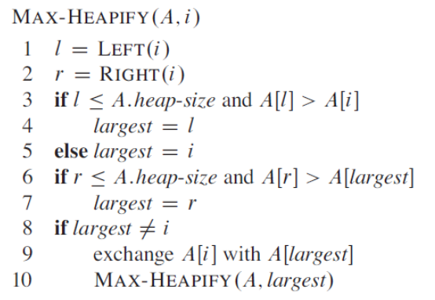
Maintaining the heap property
Check that A[i] is larger than its children
If not exchange it with its larger child, and recursively call Max-Heapify
lets the value at A[i] “float down” in the max-heap
Makes node i a max-heap root

Slide 8
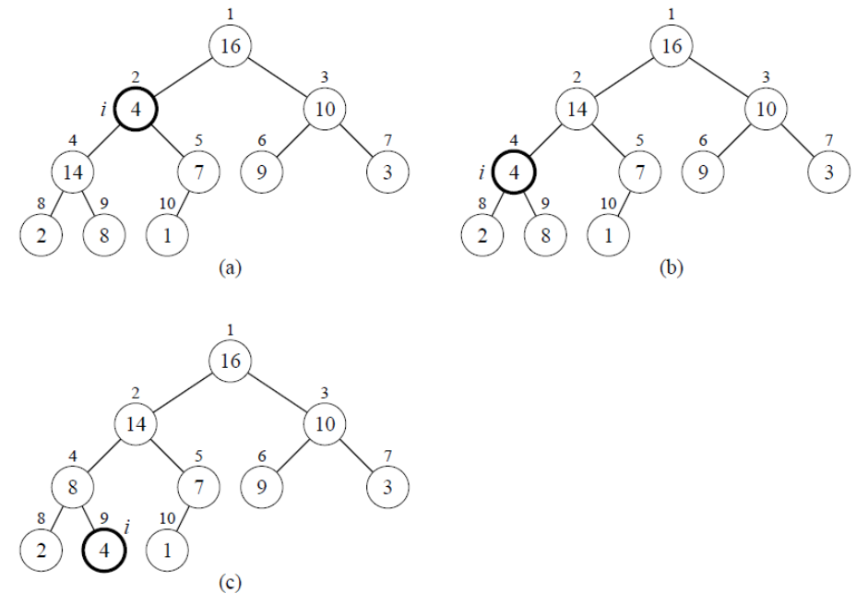
Max-Heapify Example
Node 2 violates heap property, is switched with node 4.
Then, node 4 violates heap property

Slide 9
Running time of Max-Heapify
O(h) on a node of height h
O(lg n)

Slide 10
Interview Questions
What is the effect of calling MAX-HEAPIFY(A,i) when the element A[i]is larger than its children?
What is the effect of calling MAX-HEAPIFY(A,i) for i > A.heap-size/2?
The code for MAX-HEAPIFY is quite efficient in terms of constant factors, except possibly for the recursive call in line 10, which might cause some compilers toproduce inefficient code. Write an efficient MAX-HEAPIFY that uses a loop instead of recursion.

Slide 11
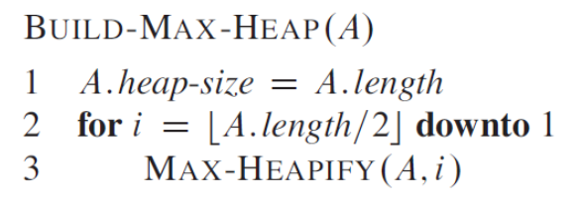
Building a heap
Starting from an unordered heap, build a heap.
Why does it operate on A.length/2 downto 1?
Running time seems to be O(n lg n) but it's really O(n)
Observe that the time for MAX-HEAPIFY to run at a node varies with the height of the node in the tree, and the heights of most nodes are small.
Notes:
A.length/2 are leaves, and those are by default already heaps
also, because of the recursive definition, we want the children to be heaps, hence start at bottom and work way up

Slide 12
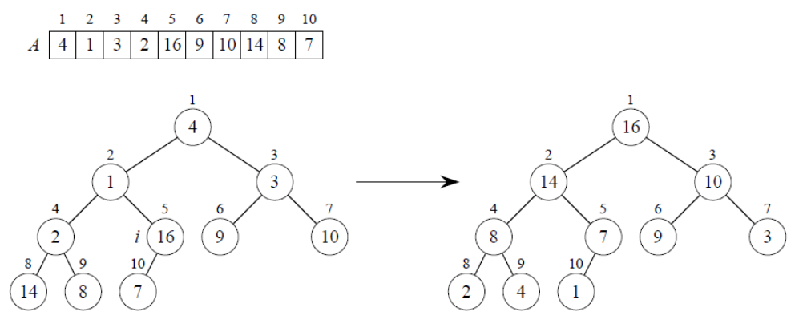
Build-Max-Heap example

Slide 13
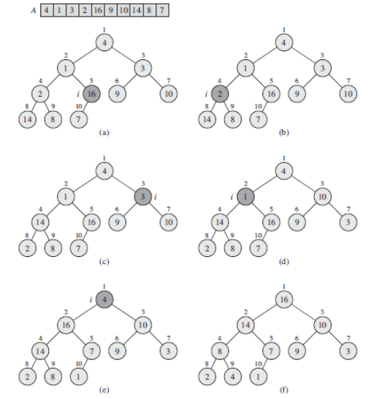
Build-Max-Heap example

Slide 14
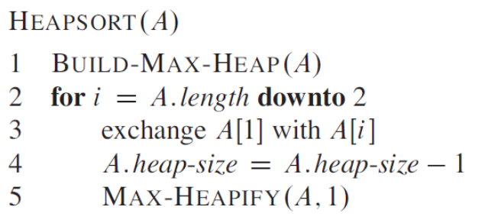
Heapsort
Build a max-heap from the array (O(n))
Place max element in its correct position by swapping it with the last item (O(1))
Decrease heap size by 1
Call max-heapify on root O(lg n) each time, n times

Slide 15
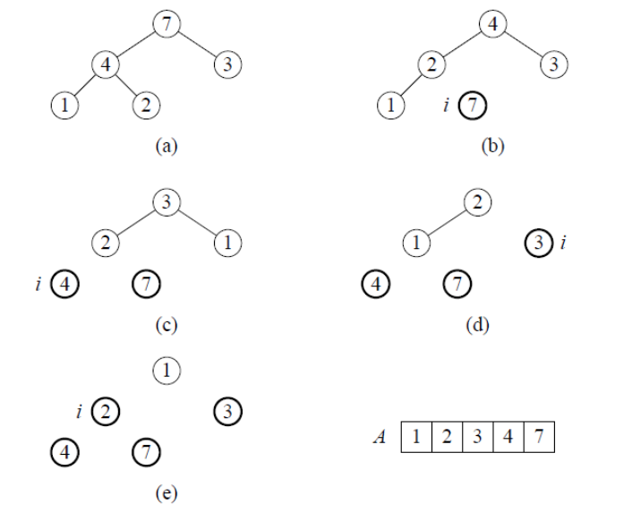
Heapsort example

Slide 16
Interview Questions
What is the running time of HEAPSORT on an array A of length n that is already sorted in increasing order? What about decreasing order?

Slide 17
Priority Queues
A priority queue is a data structure for maintaining a set S of elements, each with an associated value called a key.

Slide 18
Max-Priority Queue
A max-priority queue supports the following operations:
INSERT(S, x) inserts the element x into the set S
MAXIMUM(S) returns the element of S with the largest key.
EXTRACT-MAX(S) removes and returns the element of S with the largest key.
INCREASE-KEY(S, x, k) increases the value of element x’s key to the new value k, which is assumed to be at least as large as x’s current key value.

Slide 19
Priority Queue methods
<T> T maximum(T[ ] A) {
}
<T> T extractMax(T[ ] A) {
}
Notes:
return A[i]

Slide 20
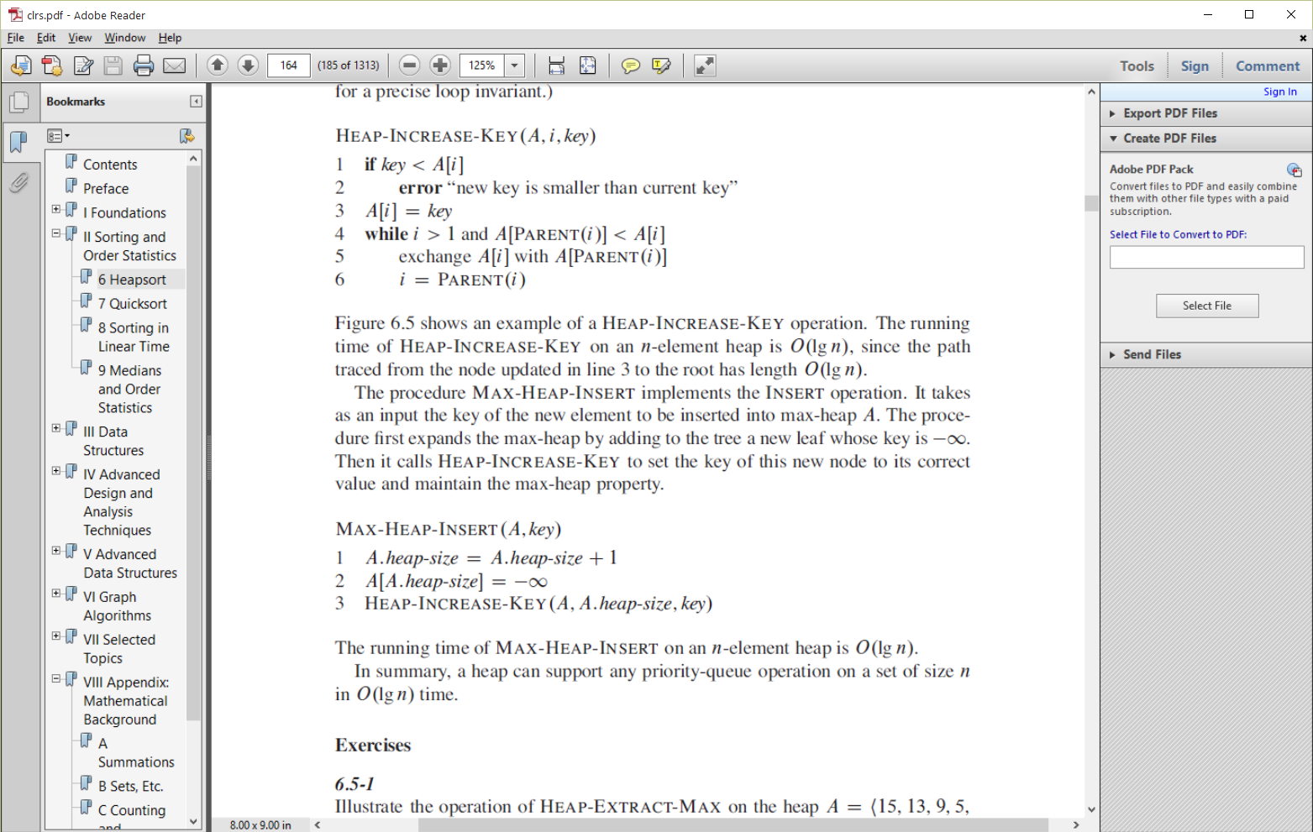
Priority Queue methods
Time complexities?

Slide 21
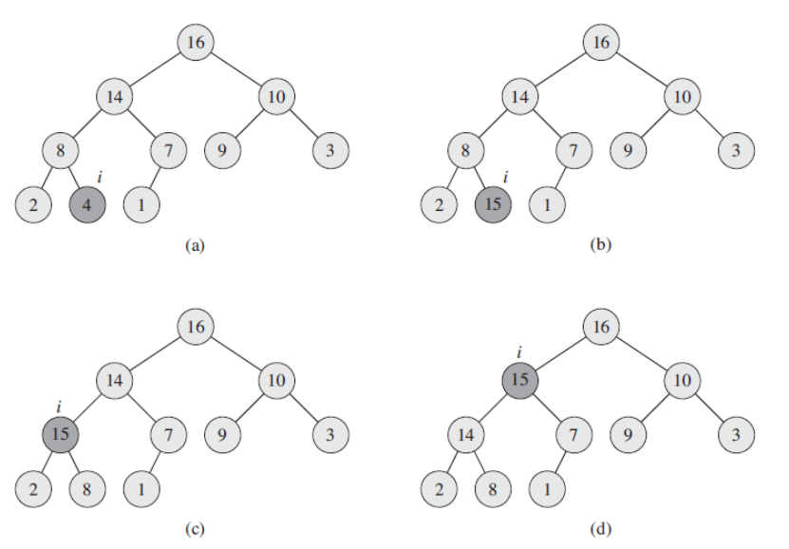
Increase-Key example

Slide 22
Interview Questions
Show how to implement a first-in, first-out queue with a priority queue.
Show how to implement a stack with a priority queue.
The operation HEAP-DELETE(A, i) deletes the item in node i from heap A. Give an implementation of HEAP-DELETE that runs in O(lg n) time for an n-element max-heap.

Slide 23
Interview Questions
Give an O(n lg k)-time algorithm to merge k sorted lists into one sorted list, where n is the total number of elements in all the input lists. (Hint: Use a min-heap for k-way merging.)

